Slide 1

Department of Information Technology
NBA Accredited A.P. Shah Institute of Technology G.B.Road, Kasarvadavli, Thane(W), Mumbai-400615 UNIVERSITY OF MUMBAI Academic Year 2021-2022

Slide 2
A Project Report on Using AI for Designing ID Cards Embedded with Invisible QR Code Submitted in partial fulfillment of the degree of Bachelor of Engineering(Sem-8)
in INFORMATION TECHNOLOGY By Dhruva Mhatre(18104045) Chirag Jain(18104002) Prem Vispute(18104059) Under the Guidance of Prof. Kiran Deshpande
Prof. Kaushiki Upadhyaya
jjj

Slide 3
1.Project Conception and Initiation

Slide 4
1.1 Abstract
This project proposes an approach for obtaining a data hiding mechanism for personal information on ID cards by using user data to develop a QR (Quick Response) code and embedding that QR code into the user image using CNN, making the QR code invisible to the naked eye.

Slide 5
1.2 Objectives
To provide data security by data hiding.
To maintain integrity and readability of the ID card by hiding the QR code and providing necessary information.
To reduce data exposure and security threat.
To develop a QR code generator using pyqrcode module in python.
Embed the QR code generated in the required image using CNN.
Retrieve the embedded QR code from the encoded image.

Slide 6
1.3 Literature Review
Sr. No. | Authors | Paper Title | Methodologies | Findings
1. | K. Yamauchi and H. Kobayashi | ”Invisible QR Code Generator Using Convolutional Neural Network | Using Convolutional Neural Networks(CNN), and FC DenseNet for embedding and restoring images | This model composes of 2 CNNs and was able to embed and restore arbitrary information in the image.
2. | Krenn, Robert | Steganography and steganalysis | Using the concept of image steganography to hide secret image inside a cover image | This model involve hiding messages by altering “noisy” areas by using methods like a least-significant bit or LSB, which directly alters the image pixels value

Slide 7
1.4 Problem Definition
Identification cards or Id cards are the most important credential for any organization and it helps uniquely identify the person or verify them. But these ID cards contains personal information of the person (e.g., Mobile no., address etc.), this information can be misused if fallen into wrong hands. In our project we are proposing a system where we will generate a QR code consisting of the user info and embed it (Invisible QR code) in the user Photo on the ID card.

Slide 8
1.5 Scope
Can be useful to institutions for generating secure ID-Cards.
Can be used in Offices.

Slide 9
1.6 Benefits for environment & Society
Can be used for creating a secure environment by hiding personal user data.
Can reduce data exposure and security threat by preventing misuse of data.

Slide 10
1.7 Technology stack
Python (pyqrcode, NumPy)
CNN (Keras, Tenserflow, Relu, Pandas, NumPy, Matplotlib)
OpenCV

Slide 11
2. Project Design

Slide 12
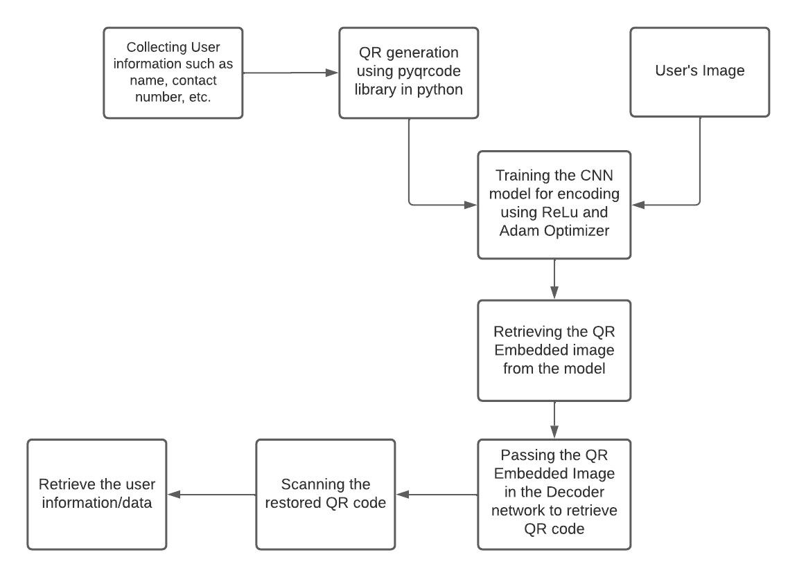
2.1 Proposed System

Slide 13
2.2 Design(Flow Of Modules)
The QR code generator takes user data as input in the form of text
The QR code generates a QR code using user info.
The QR code image and the user image is given as input to the Encoder CNN.
Encoder CNN embeds the QR image into the user such that QR is invisible to the naked eyes.
The output of the Encoder CNN is given as input to decoder CNN.
Decoder CNN gives us the decoded QR code as output.
The decoded QR code is scanned and user information is retrieved.

Slide 14
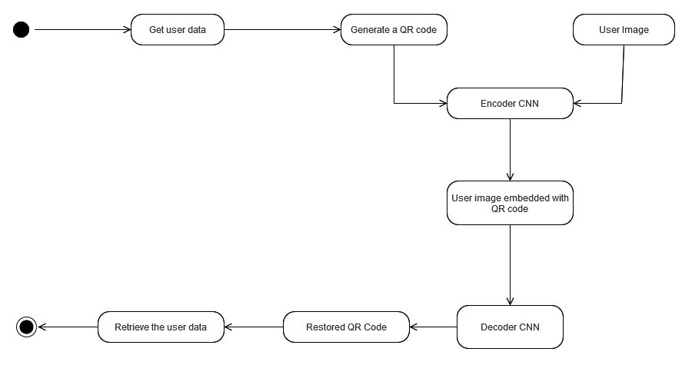
2.2 Design(Flow Of Modules)

Slide 15
3. Implementation

Slide 16
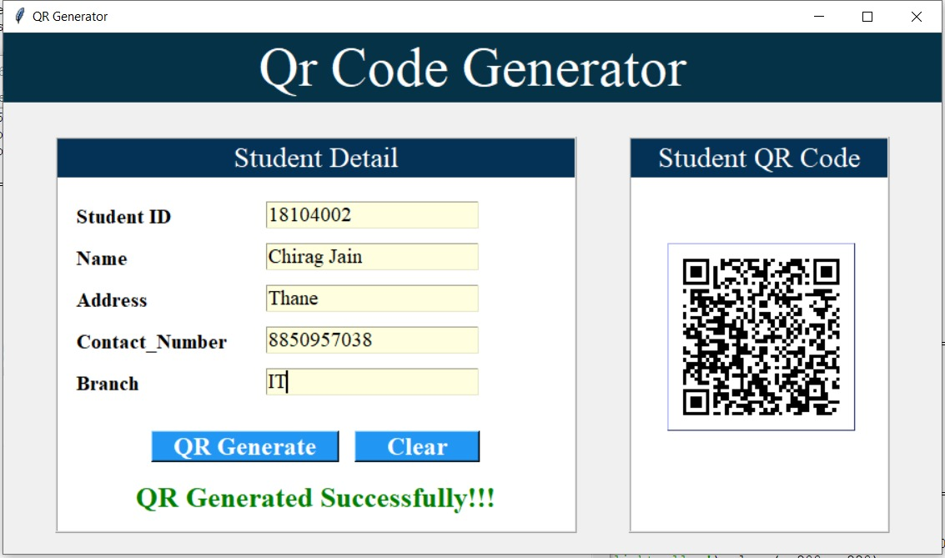
3.1 Implementation of QR code Generator

Slide 17
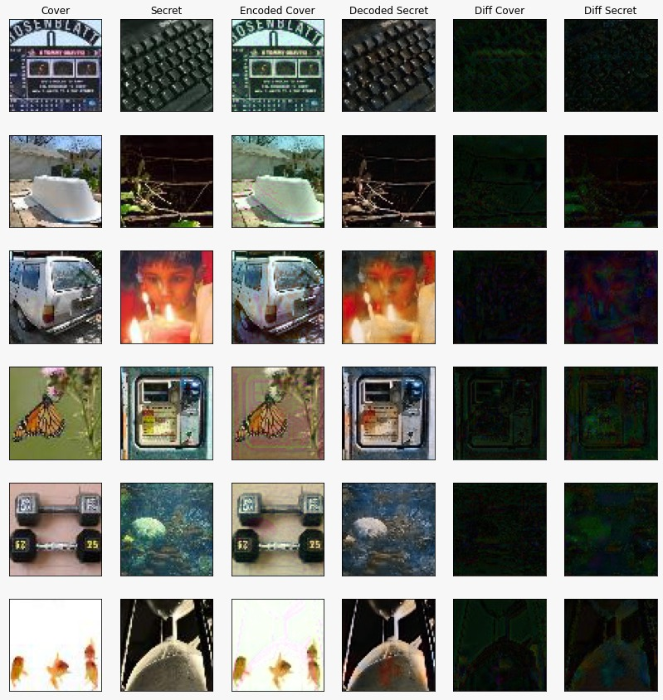
3.2 Implementation of CNN for Tiny-ImageNet dataset

Slide 18
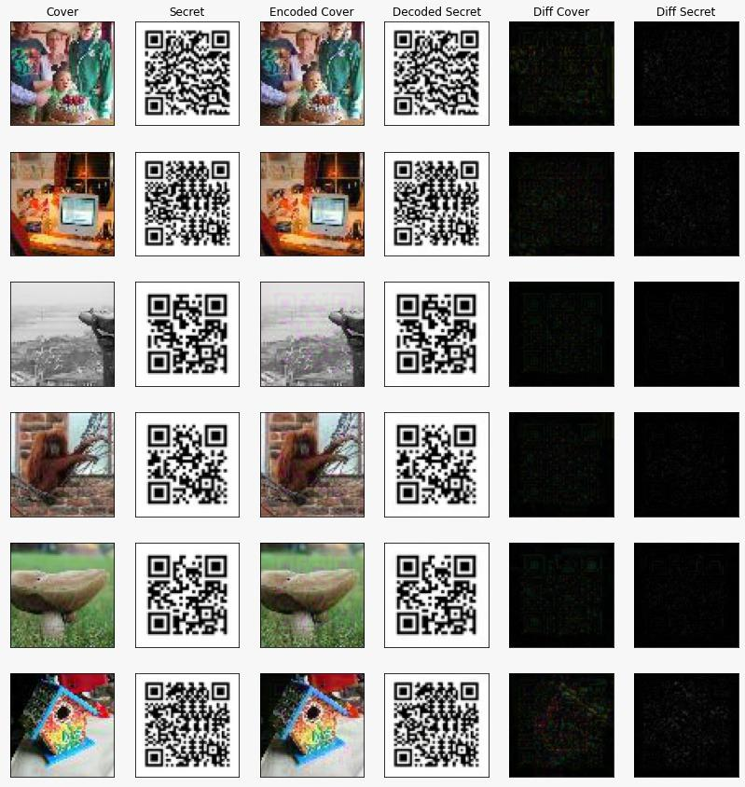
3.2 Implementation of Encoder & Decoder CNN

Slide 19
5. Result

Slide 20
5. Result
We have created a model which embeds qr code into a image using convolutional neural networks.

Slide 21
6. Conclusion and Future Scope

Slide 22
6.1 Conclusion
This projects provides an adequate data hiding mechanism for protecting this sensitive data. Here we are achieving data security by generating a QR code consisting of the user’s information, and then we will embed the generated QR are into the user’s image such that the very existence of the QR will be unknown, i.e., the QR code will be invisible to the naked eyes

Slide 23
Can be applied in attendance system for institution.
Can be applied for ticketing system for railways, buses, etc.
6.2 Future Scope

Slide 24
References
K. Yamauchi and H. Kobayashi, ”Invisible QR Code Generator Using Convolutional Neural Network,” IECON 2020 The 46th Annual Conference of the IEEE Industrial Electronics Society, 2020
S. Albawi, T. A. Mohammed and S. Al-Zawi, ”Understanding of a convolutional neural network,” 2017 International Conference on Engineering and Technology (ICET), 2017
Krenn, Robert. ”Steganography and steganalysis.” (2004): 2007.

Slide 25
International Conference on Computational Intelligence and Innovative Technologies (ICCIIT – 2022) – Elsevier SSRN series
Paper Publication

Slide 26
Thank You

